Slide 1
Academic Writing And Its Types

Slide 2
Academic writing
Academic writing is a concise, focused, structured form of writing based on evidence
Academic writing - a style of expression - researchers use to define the intellectual boundaries of their disciplines/ expertise.
Organizes ideas in a formal order or structure - references from academic literature

Slide 3
Examples of academic writing
Essays
Dissertation/Thesis
Laboratory reports
Conference paper
Journal Articles
Book reviews
Case-studies

Slide 4
Purpose of Academic writing
The most common purposes in academic writing are :
Persuade
Analyze/synthesize
Inform.
Notes:
References :
file:///C:/Users/admin/AppData/Local/Temp/academicwritingguide-3.pdf

Slide 5
Purpose of Academic writing
Persuasive purpose– argumentative writing
To give an answer to a question
Make your readers accept your answer.
Should support your answer using reason and evidence

Slide 6
Purpose of Academic writing
Analytical purpose– analyze papers - critical analyses
To explain and evaluate possible answers to your question
Investigate causes, examine effects, evaluate effectiveness ,assess ways to solve problems,

Slide 7
Purpose of Academic Writing
Analytical - find the relationships between various ideas, or analyze other people’s arguments.
Synthesize the different arguments and come up with your own answer to the question.

Slide 8
Purpose of Academic Writing
Informative academic writing
To explain possible answers to your question
Give the readers new information about your topic.
Differs from an analytical topic - you do not push your viewpoint on the readers - rather provide new facts/information

Slide 9
Characteristics of Academic writing
Formal vocabulary
Precision
Objectivity

Slide 10
Formal vocabulary
Academic texts avoid casual or conversational language and to do this they make use of formal vocabulary.
Examples:
(a) Avoid the use of ‘somewhat’ c.f. –( confer) compare, ‘a bit’;
(b) Avoid contractions like didn’t and using ‘did not’ instead;

Slide 11
Formal vocabulary
c) Avoid emotional tones such as ‘wonderful or ‘terrible’ and using moderate phrases such as ‘helpful’ or ‘problematic’;
(d) Avoid the use of absolute positives and negative such as ‘wrong’ and opting instead for words like ‘less convincing’

Slide 12
Precision
Academic writing makes committed efforts to be precise when presenting information.
Imprecise or ambiguous terms such as “a lot of people” are generally avoided in favor of stating exact figures such as “50 million people”.
HCL is far from the bus station.
HCL is 5 kms away from the bus station.

Slide 13
Objectivity
Objective language is used in academic writing
Emphasis is on the information and the arguments- rather on the writer.
Nobody really wants to know what you "think" or "believe".
Example:
Prof. X’s mathematics class is better than every other class.
Prof. X’s class had an average score of 95% on the math exam; while the average score for the other classes was 80%.

Slide 14
Academic writing | Non academic writing
Formal language, use technical and formal vocabulary. | Simple language, use informal phrases and slangs.
Signal words to indicate organizational pattern of the work. | Short introduction, suiting the subject.
Formal introductory paragraph containing statement. | Informal and without any predictable pattern
Body paragraphs are long and with each sentence serving a specified purpose. | Main body paragraphs are shorter in length like topic sentence, substantiation and transition.

Slide 15
Academic writing | Non academic writing
Elaborate explanation of the central idea or argument with supporting expert sources. | Ideas are elaborated well, but not supported with expert sources.
Referencing | Personal stories or impressions and no referencing
Other’s ideas and answers incorporated to in body paragraphs as direct quotations, paraphrasing. | Direct quotations from others without citing sources.
Author’s stand on the issue raised in the essay, but without expressions like ‘I think’, ‘In my view’. | Author expresses opinion directly as ‘I’
Tables | No tables and figures
Precise figures. | Approximate figures

Slide 16
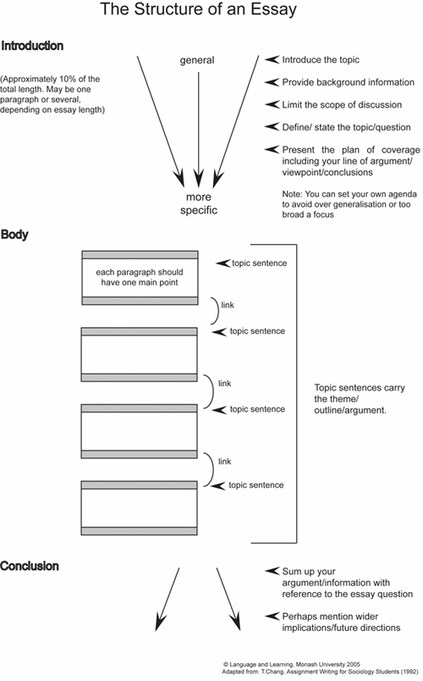
Anatomy of an Academic Text
The Classic Essay
Source: English Skills One (2018)

Slide 17
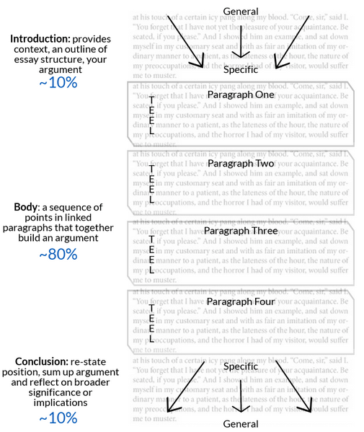
Anatomy of an Academic Text
The Classic Essay
Source: Monash University (n.d.)

Slide 18
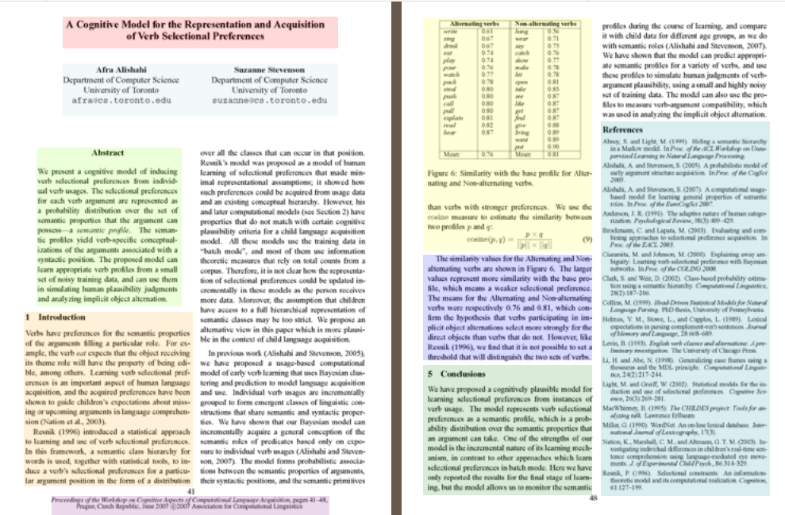
Anatomy of an Academic Text
The Academic Article
Source: NCSU Libraries (2009)

Slide 19
Anatomy of an Academic Text
Parts of an Academic Article
Title
Authors
Financial equipment Support
Abstract
Introduction
Literature review
Main body
Conclusion
Acknowledgements
References
Source: NCSU Libraries (2009)

Slide 20
Topic sentence – the first sentence in a body paragraph that tells the reader what the main idea or claim of the paragraph will be.
Explanation – Explain what you mean in greater detail.
Evidence – Provide evidence to support your idea or claim. To do this, refer to your research. This may include: case studies, statistics, documentary evidence, academic books or journal articles. Remember that all evidence will require appropriate citation.
Comment – Consider the strengths and limitations of the evidence and examples that you have presented. Explain how your evidence supports your claim (i.e. how does it ‘prove’ your topic sentence?).
Link – Summarise the main idea of the paragraph, and make clear how this paragraph supports your overall thesis.

Slide 21
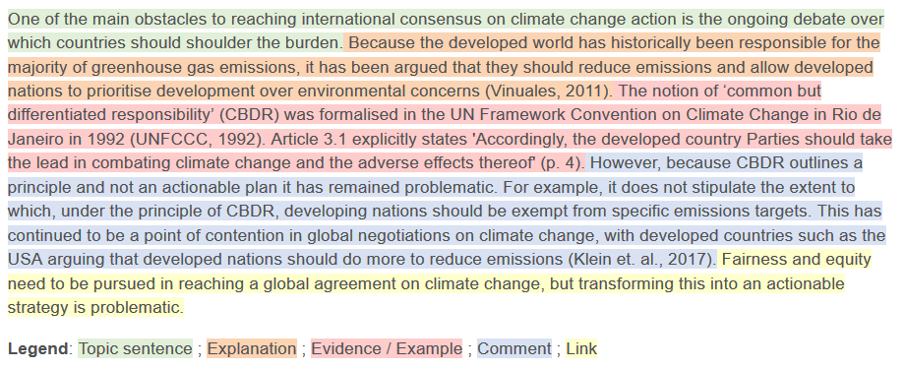
Anatomy of an Academic Text
Parts of an Academic Article
Title
Authors
Financial equipment Support
Abstract
Introduction
Literature review
Main body
Conclusion
References
Figure: Using TEEcL when Structuring a Paragraph

Slide 22
Process – Academic writing Note making- Skill
Note taking – refers to the process of writing useful information – lecture, text books, journal articles etc. –application, comprehension, knowledge
Note making – more an active process – critical approach – evaluation, synthesis and analysis.
Notes:
Source: Note making - Wolfson College Academic Skills - LibGuides at University of Cambridge Subject Libraries

Slide 23
Process – Academic writing Note making
Your notes should not just restate, or describe the content of a text or a lecture.
Notes should be interpreted in the context of your overall knowledge of the subject
If you are copying verbatim, it should be cited in your essay/article/report with references
Methods- Linear, pattern(concept mapping), columns (Cornell)

Slide 24
Note Making – Approaches Linear
Continuous form of note making,
Structure with headings and highlight key points by underlining and using capitals
Keep it brief using symbols, abbreviations and bullet points
Prioritize sections by adding numbers
Leave good margins so you can add additional notes and reflections later
Separate direct quotes and your own ideas using square brackets or a different color.

Slide 25
Note making - Pattern
Also known as mind-mapping/ concept mapping
This approach organizes keywords and concepts around a main theme in the center of the page.
Learn visually - useful – as it is easy to make links to new and existing knowledge and add extra thoughts later on.
Use of colors or images to help you remember points.
Try not to fill up the page, but leave space for questions that arise.
Need to revisit - to add a hierarchy to your ideas.

Slide 26
Note making – Columns
Cornell method - Organize your page into three areas - is particularly useful for lecture notes
Draw a line down the middle of your page
Write key points on one side
Put your own comments and questions on the other
Include bibliographic details at the top and a summary section at the foot of the page.
Helpful when you need to revisit your notes if revising or writing up.

Slide 27
Note making - stages
However you decide to make notes, try to approach it in several stages:
Scan – record bibliographic information and the structure of the text
Skim – record keywords, citations and ask questions
In-depth – review your notes - make critical comments and evaluate ideas in your own words.

Slide 28
Types Of Academic Writing
Descriptive
Analytical
Persuasive
Critical

Slide 29
Descriptive
The simplest type of academic writing
Its purpose is to provide facts or information. reports the findings of experiments - summarises the subject.
e.g. a summary of an article or a report of the results of an experiment.
The kinds of instructions for a purely descriptive assignment include: 'identify', 'report', 'record', 'summarise' and 'define'.

Slide 30
Analytical
Analytical writing gives facts and information – includes descriptive writing
Re-organize the facts and information into categories, groups, parts, types or relationships.
Explores relationships of ideas or parts of something by comparing and contrasting

Slide 31
Analytical (Contd.)
Example : If you’re comparing two theories, break your comparison into several parts:
how each theory deals with social context, how each theory deals with language learning
how each theory can be used in practice.
The kinds of instructions for an analytical assignment include: 'analyse', 'compare', 'contrast', 'relate', and 'examine'.

Slide 32
Tips for Analytical Writing
Brainstorm the facts and ideas - try different ways of grouping them - to patterns, parts, similarities and differences.
You could use colour-coding, flow charts, tree diagrams or tables.
Create a name for the relationships and categories you find. e.g. advantages and disadvantages.
Build your paragraph around one of the analytical categories.
Make the structure of your composition clear - by using topic sentences and a clear introduction.

Slide 33
Persuasive Writing
Persuasive writing has all the features of analytical writing ( information & re-organising the information)- addition - your own point of view.
Used to convince the reader on the purpose and to accept the new knowledge claims
Used to convince that the research is necessary and useful.
To state that the statistical methods used were useful and informative
To persuade that the results make sense and contribute to a consistent body of knowledge

Slide 34
Persuasive Writing
Most essays are persuasive, - there is a persuasive element - the discussion and conclusion of a research article.
Points of view in academic writing - include an argument, recommendation, interpretation of findings or evaluation of the work of others.
In persuasive writing, each claim needs to be supported by some evidence
e.g. a reference to research findings or published sources.
The kinds of instructions for a persuasive assignment include: 'argue', 'evaluate', 'discuss', and 'take a position'.

Slide 35
Tips for persuasive Writing
To present your argument, make sure:
your text develops a coherent argument - all the individual claims work together - to support your overall point of view
your reasoning for each claim is clear to the reader
your assumptions are valid
you have evidence for every claim you make
you use evidence that is convincing and directly relevant.

Slide 36
Critical Writing
While persuasive writing requires you to have your own point of view on an issue or topic, critical writing requires you to consider at least two points of view, including your own.
Gives opinions (positive and negative)
Weighs evidence and draws conclusions
Makes logical connections between theory and practice
Outlines implications and solutions
Draws conclusions and makes recommendations

Slide 37
Critical Writing
E.g. - explain a researcher's interpretation or argument and then evaluate the merits of the argument, or give your own alternative interpretation.
Examples of critical writing assignments - critique of a journal article, or a literature review that identifies the strengths and weaknesses of existing research.
The kinds of instructions for critical writing include: 'critique', 'debate', 'disagree' and 'evaluate'.

Slide 38
Tips for Critical Writing
You need to:
accurately summarize all or part of the work – identify the main interpretations, assumptions or methodology.
have an opinion about the work – point out some problems with it,
propose an alternative approach that would be better, and/or defend the work against the critiques of others.
provide evidence for your point of view. - such as logical reasoning, reference to authoritative sources and/or research data.
Note: Critical writing requires strong writing skills. You need to thoroughly understand the topic and the issues. You need to develop essay/paragraph structure that allows you to analyze different interpretations and develop your own argument, supported by evidence.

Slide 39
Sample Paragraphs
Critical:
Brown (2005) maintains that leadership is an essential quality in nursing. This is confirmed by the recent requirements of the NHS Plan (DOH, 2002). This Plan has emphasized the importance of introducing the transformational model of leadership. Smith (2001) explains that this is a leadership which involves the use of charisma and interpersonal skills to enable achievement. Jones (2004) argues that the key characteristic of transformational leadership is empowering others to achieve. In my own experience, a leader with transformational qualities can make any team member feel that they have a useful part to play in the organization. This is confirmed by Fea (2001) who argues that transformational leadership increases feelings of self-worth and capability in their team members

Slide 40
Cont..
Is this piece an example of good academic writing?
Yes , the style is formal and flows well.
Paraphrasing (rather than quotations) is used to introduce evidence from the literature
How well does it use literature to back up statements being made?
Literature is used to make a number of points. An attempt is made to
find answers in the literature.
However, each citation is not really explored or interpreted by the student
To what extent is it reflective?
There is some reflection on the part of the student and answers from the literature are used to confirm these feelings.
The student does not go far enough in trying to explain/justify these feelings.
To what extent is it analytical and critical?
There is an attempt to analyse the topic but this is not done in great
depth.
The student does not question/evaluate the evidence from the literature
and therefore shows limited critical thinking.

Slide 41
Other Example:
A review of the available literature provides a wealth of examples of authors advocating leadership as an essential quality in nursing. For example, Shackleton (1950) emphasises that nursing needs strong leadership and recommends a strong transactional approach of reward and punishment to get results and promote teamwork. However, more recently, authors have moved towards the concept of charismatic and transformational leadership (Smith, 2001; Jones, 2004). These qualities are also an integral part of the new recommendations in the NHS Plan (DOH 2002).
Charisma appears to be a complex phenomenon to define. Davidzhar (1991) suggests that it is an aspect of personality which makes the individual irresistible to others, in terms of their ability to persuade and empower others. However, other authors, such as Romano (1996) and Harvey (2000) highlight the intangible nature of charisma and emphasise the frustrating point that individuals know charisma if they see it, but find it difficult to define.
It appears problematic, therefore, to identify exactly how charisma can become an integral part of developing transformational leadership in nursing, if it is a quality which, in itself, is difficult to define. For example, Smith (2001) maintains that transformational leadership uses a combination of charisma and interpersonal skills to enable achievement. However, identifying potential transformational leaders may be a difficulty if the pre-requisite for identifying charismatic individuals is an integral part of this selection process.
Jones (2004) argues that the key ability of a transformational leader is the ability to empower others, while Fea (2001) maintains that their key strength is to increase feelings of self-worth and capability in their team members. On reflection, my own experience of transformational leadership appeared to be based principally on being persuaded, by the sheer force of personality of the individual, that I had the potential to contribute and achieve. It seemed to me that it was their apparent faith in me and their power of persuasion that enabled me to become an effective team member.
This requirement for charisma in transformational leadership, therefore, may indeed be based on individual personality factors that enable others to feel good about themselves and their achievements. There is some evidence that this is the case. Jones (2003), for example, argues that transformational leaders are born and cannot be made. Regisara (2003) also maintains common key personality traits can be identified in effective transformational leaders, which have probably been present since childhood. It seems, therefore, that the key requirement of the NHS Plan (2002) for the training of transformational leaders is not as straightforward as they first envisioned, as the available literature suggests that these leaders are born, rather than made.

Slide 42
How different is this piece of writing?
The issue is explored in considerably more depth
The student constantly tries to find answers in the literature, particularly finding different definitions and interpretations of the key issue.
Once the literature is presented, the student puts their own “spin” (interpretation) on it
Personal thoughts and reflections are always followed up by attempts to find supporting evidence (substantiation) in the literature
The complexity of the issue is recognised. Things are not presented simplistically as “black and white”. Instead, shades of grey are acknowledged.
The student’s “voice” is heard throughout, trying to make sense of what they have read and comparing it with what they have experienced.

Slide 43
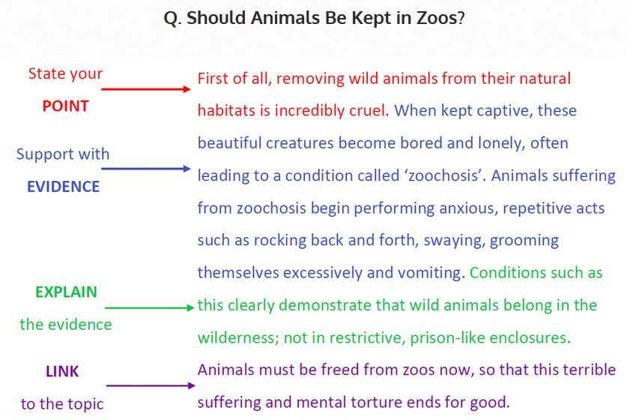
Analytical

Slide 44


Slide 45

Persuasive

Slide 46
How to Apply Different Types of Writings in a Report/Proposals?
You will use critical writing in the literature review to show where there is a gap or opportunity in the existing research
The methods section will be mostly descriptive to summarize the methods used to collect and analyze information
The results section will be mostly descriptive and analytical as you report on the data you collected
The discussion section is more analytical, as you relate your findings back to your research questions, and also persuasive, as you propose your interpretations of the findings.

Slide 47
Academic Integrity
Academic integrity / academic honesty is the foundation for academic life.
The five fundamental values in this academic process are: honesty, trust, respect, fairness and responsibility.
Academic integrity is the commitment to live by these values.
Plagiarism is an aspect of academic integrity in which using another's ideas, words, theories, illustrations or graphics, opinions or facts without giving credit is dishonest.

Slide 48
References
Stephen Bailey, Academic Writing: A Handbook for International Students, 5th Edition, Special Indian Edition, Routledge, 2018.
www.uefap.com (accessed on 5th June 2021)
https://academicintegrity.uoguelph.ca/ (accessed on 5th June 2021)
Note making - Wolfson College Academic Skills - LibGuides at University of Cambridge Subject Libraries (accessed on 22nd September, 2022)
ASK Academic Skills (n.d.) 'The Power of the Paragraph', Available online: https://vimeo.com/44666462 [Accessed on 5th June 2019]
Best Custom Writing (2018) 'The 4 Types of Academic Writing' Available online:https://www.bestcustomwriting.com/blog/types-of-academic-writing [Accessed on 5th June 2019]
Branson, R. D. (2004) ‘The Anatomy of an Academic Article’ in Respiratory Care, Vol. 49 (October), No. 10. Available online: http://www.rcjournal.com/contents/10.04/10.04.1222.pdf [Accessed on 5th June 2019]
English Skills One (2018) 'Unit II - Genres and Types of Academic Writing' Available online: https://www.englishskillsone.com/units-1-iv/c/0/i/21114864/unit-ii-genres-and-types-academic-writing [Accessed on 5th June 2019]

Slide 49
References (Contd.)
Hartley, J. (2008) Academic Writing and Publishing: A practical handbook. New York: Routledge.
Lund University (2011) 'Academic Writing in English', Available online: https://awelu.srv.lu.se/sources-and-referencing/writing-acknowledgements/ [Accessed on 5th June 2019]
Medawar, P (1964) ‘Is the Scientific Paper a Fraud?’ Listener. 1963;70:377–378. Available Online: http://www.weizmann.ac.il/mcb/UriAlon/sites/mcb.UriAlon/files/uploads/medawar.pdf [Accessed on 5th June 2019]
Monash University (n.d.) 'Research and writing for assignments'. Available online: https://www.monash.edu/rlo/research-writing-assignments/writing/clear-communication/writing-clearly-concisely-and-precisely [Accessed on 6th June 2019]
NCSU Libraries (2009) 'Anatomy of a Scholarly Article' Available online: https://www.lib.ncsu.edu/tutorials/scholarly-articles/ [Accessed on 5th June 2019]
UEFAP (n.d.) 'Features of Academic Writing'. Available online: http://www.uefap.com/writing/feature/precise.htm [Accessed on 6th June 2019]
University of Sydney (2019) 'Writing' Available online: https://sydney.edu.au/students/writing.html [Accessed on 5th June 2019]

Slide 50

Thank you

